Slide 1
Introduction Title: Stay Safe: Phishing Awareness & Prevention Subtitle: Protecting Our Teams from Cyber Threats
Welcome! Today, we’ll learn how to identify and avoid phishing attacks, ensuring our teams remain secure.

Slide 2
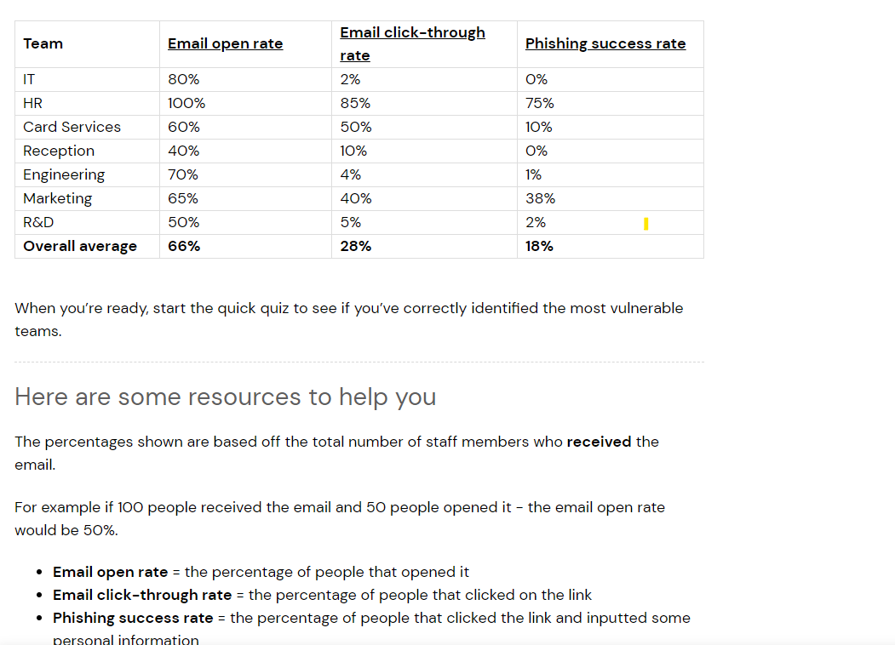
Familiarize yourself with phishing attacks Phishing Results:

Slide 3
What is phishing?
Phishing is a type of cyber attack where attackers pose as legitimate organizations or individuals to steal sensitive information, like passwords or credit card numbers. They often use emails that look trustworthy to trick you into clicking malicious links or providing confidential data.

Slide 4
Phishing Types
Email Phishing:
The most common type.
Attackers send mass emails posing as legitimate organizations.
Often includes a malicious link or attachment.
Spear Phishing:
Targeted attacks aimed at specific individuals or organizations.
Uses personal information to appear more convincing.
Harder to detect due to its personalized nature.
Whaling:
Targets high-profile individuals like executives.
Often involves requests for large financial transactions or sensitive information.
Highly customized and sophisticated.
Vishing:
Phishing via voice calls.
Attackers pretend to be from reputable companies or institutions.
Goal is to extract personal or financial information.
Smishing:
Phishing via SMS (text messages).
Usually includes a link to a malicious site or a prompt to call a fraudulent phone number.

Slide 5
Learn to spot phishing emails
Common phishing tactics include:
Urgency: “Act now or lose access!”
Suspicious Links: Hyperlinks masked as legitimate but lead to harmful sites.
Unexpected Requests: Asking for sensitive information out of the blue. Example: An email claiming your account is compromised, urging you to click a link to reset your password.

Slide 6
How do we stop getting phished?
Tips to protect yourself:
Verify the sender: Always double-check the sender’s email address.
Hover over links: Before clicking, hover over any link to see the actual URL.
Don’t share personal info: Never provide sensitive details via email.
Report suspicious emails: If something seems off, report it to IT immediately.

Slide 7
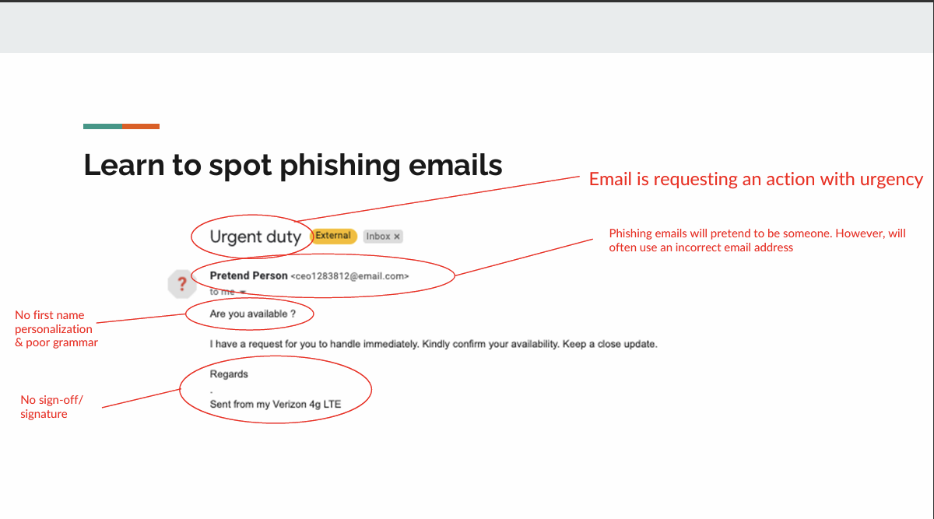
How do we stop getting phished?

Slide 8
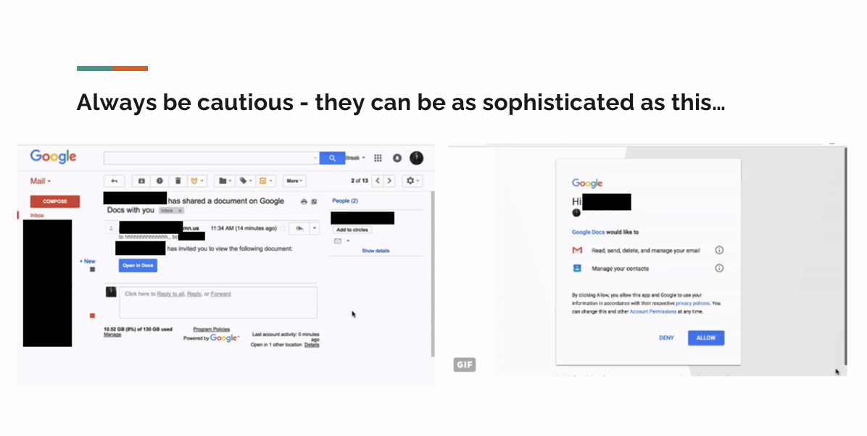

Slide 9
Conclusion
Phishing attacks can happen to anyone. By staying informed and cautious, we can protect ourselves and our organization from these threats. Remember, when in doubt, don’t click!

